Slide 1
SMART PERSONAL FINANCE AUTOMATOR
CSE7101- Capstone Project
Review-1
Batch Number:CSE_79
Under the Supervision of,
Ms.Sreelatha P.K
Assistant Professor
School of Computer Science and Engineering
Presidency University
Roll Number | Student Name
20211CSE0493 20221CSE0492 20221CSE0334 | Arunachalam T Vaishnavi Sastry S Rakshitha DS
Name of the Program: BTECH Computer Science And Engineering
Name of the HoD: Dr.Asif Mohammed and Dr. Blessed Prince
Name of the Program Project Coordinator: Dr. Jayavadivel Ravi
Name of the School Project Coordinators: Dr. Sampath A K , Dr. Geetha A

Slide 2
Problem Statement Number: PSCS_154
Organization : Smart Automation
Category (Hardware / Software / Both) : Software
Problem Description : The "Smart Personal Finance Automator" is a web-based application designed to address the challenges of manual expense management. The system will automatically ingest and parse financial transaction data from bank SMS and email alerts. Using Natural Language Processing (NLP), it will intelligently extract key details like transaction amount, vendor, and date. This structured data is then used to auto-categorize expenses and generate interactive visual reports. The platform aims to provide users with a seamless and insightful overview of their spending patterns and offer personalized recommendations to improve their budgeting and saving habits, ultimately fostering better financial health.

Slide 3
Content
Problem Statement
Manual expense tracking is a tedious, time-consuming, and error-prone process. Most individuals struggle to gain clear, real-time insights into their financial health due to unstructured data scattered across bank SMS alerts and email notifications. This lack of automated analysis prevents effective budgeting, identifying wasteful spending, and making informed financial decisions, leading to poor financial discipline and missed savings opportunities.

Slide 4
Content (continuation)..
Objectives
The primary objectives of this project are to:Automate Data Extraction: Design and develop a robust system to automatically parse and extract transaction data from unstructured bank SMS and email text.
Develop an NLP Categorization Model: Implement and train a Natural Language Processing model using Python and spaCy to intelligently classify transactions into relevant spending categories (e.g., groceries, utilities, transport).
Create an Interactive Dashboard: Build a secure, user-friendly web interface with an interactive dashboard using Plotly/Dash to visualize spending trends, category breakdowns, and monthly financial summaries.
Generate Savings Insights: Engineer a recommendation engine that analyzes user spending patterns and provides personalized, actionable suggestions to optimize expenses and improve savings.
Ensure Secure Access: Implement user authentication and ensure the encrypted storage of all sensitive financial data to maintain user privacy and security.

Slide 5
Content (continuation)..
Background and Related work for title Selection
Evolution of Tools: Personal finance management has progressed from manual ledgers and digital spreadsheets to automated mobile applications.
Commercial App Limitations:
Popular apps like Mint and Walnut often require direct bank access, which raises security concerns for many users.
Their categorization rules are often too generic and struggle to parse the diverse SMS formats from various Indian banks.
SMS-Parser App Gaps: Simpler apps that focus only on SMS parsing typically lack sophisticated analytics, personalized recommendations, and a comprehensive web dashboard.
Our Project's Approach:
We will build on existing academic research in Natural Language Processing (NLP).
Our plan is to create a custom-trained NER (Named Entity Recognition) model to accurately handle the varied syntax of transaction alerts.
This will be integrated into a full-stack application focused on delivering secure, actionable insights.

Slide 6
Analysis of Problem Statement
Technology Stack Components:
Frontend: HTML, CSS, JavaScript, React.js
Backend: Python (Flask)
Natural Language Processing (NLP): spaCy, Pandas, Regex
Data Visualization: Plotly/Dash
Database: PostgreSQL / MySQL
APIs & Integration: Email Parsing (IMAP), SMS Simulation (Twilio)

Slide 7
Analysis of Problem Statement (contd...)
Software and Hardware Requirements:
Hardware:
Processor: Intel Core i3 / AMD Ryzen 3 or higher
RAM: 8 GB or more
Storage: 40 GB of free disk space
Software:
Operating System: Windows 10/11, macOS, or any Linux distribution
Backend Runtime: Python 3.8+Frontend Runtime: Node.js
Database Server: PostgreSQL or MySQL
Version Control: Git
IDE: VS Code or PyCharm

Slide 8
Analysis of Problem Statement (contd...)
The Core Issue: The central process of manual expense tracking is fundamentally flawed. It is described as tedious, time-consuming, and error-prone. This immediately highlights a clear user frustration.
The Root Cause: The problem originates from data that is unstructured and scattered. By specifying the sources as "bank SMS alerts and email notifications," you pinpoint the exact technical challenge: processing inconsistent, messy text data.
The Negative Consequences: This is the most crucial part, as it details the real-world impact of the problem. A lack of automated analysis leads to:
An inability to gain clear, real-time insights.
Ineffective budgeting.
Failure to identify wasteful spending.
Poor financial discipline and missed savings opportunities.

Slide 9
Analysis of Problem Statement (contd...)
Problem statement directly justifies a project with features such as:
Automated Data Extraction to solve the "tedious" and "time-consuming" nature of the task. A custom NLP engine to handle the "unstructured and scattered" data from various sources.
An interactive dashboard to address the "lack of clear, real-time insights.
"Savings recommendations to combat "poor financial discipline and missed savings opportunities."

Slide 10
Innovation or Novel Contributions
The innovation of this project lies in the synergistic integration of several key technologies to create a practical and user-centric solution.
Custom-Trained NLP for Financial Texts: Instead of relying on generic parsing rules, this project will develop a custom-trained spaCy NER model. This model will be specifically designed to handle the diverse and often inconsistent formats of SMS and email alerts from various Indian financial institutions, offering higher accuracy in data extraction.
Automated End-to-End Financial Feedback Loop: The system creates a complete cycle: it automatically ingests raw data, transforms it into structured insights, visualizes these insights for the user, and then uses the analysis to provide personalized, actionable savings recommendations, directly helping users modify their financial behavior.
Secure, User-Controlled Open-Source Platform: Unlike many commercial alternatives that require direct access to bank accounts, this model operates on user-provided data (via file uploads or email integration), giving users more control and security. By building it with an open-source stack, it provides a transparent and adaptable framework.

Slide 11
Github Link
https://github.com/Uniqueidentity10100/AI-based-smart-finance-Automator

Slide 12
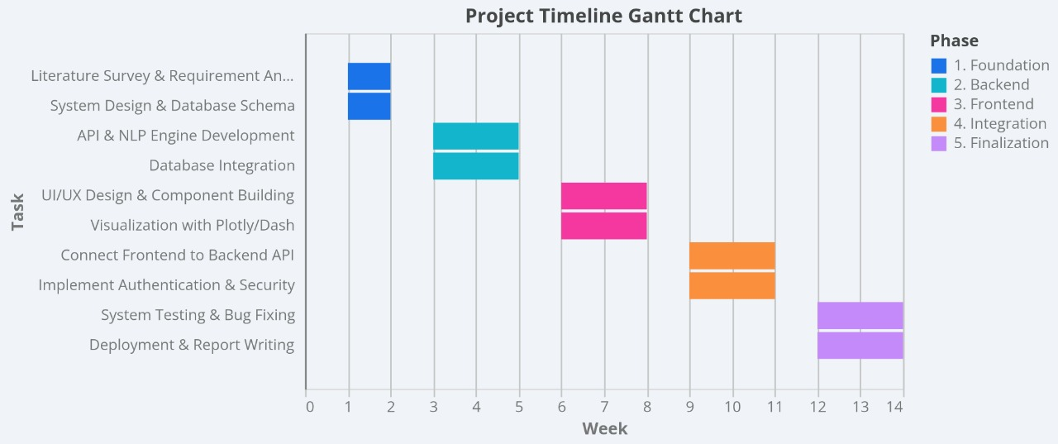
Timeline of the Project (Gantt Chart)

Slide 13
References (IEEE Paper format)
[1] https://www.researchgate.net/publication/381563265_An_AI-Powered_Personal_Finance_Assistant_Enhancing_Financial_Literacy_and_Management?__cf_chl_tk=Ivfyow_XqRGgc5ZNHOgukP5mkhwtnBt52vVgjEr53ic-1755024354-1.0.1.1-Yv9ogT01kzmUX3ekTvu8EAi6YWy_LRyc6f6._H78oU0
[2] https://www.iosrjournals.org/iosr-jce/papers/Vol27-issue1/Ser-1/B2701010717.pdf
[3] https://www.scitepress.org/Papers/2023/126139/126139.pdf

Slide 14


